Slide 1
OPTIMIZATION OF Ge/Si CORE/SHELL NANOPARTICLE PROPERTIES THROUGH NONTHERMAL PLASMA SYNTHESIS
Yifan Gui¹, Jordyn Polito² and Mark J. Kushner³
¹Department of Nuclear Engineering and Radiological Sciences
²Department of Chemical Engineering
³Department of Electrical Engineering and Computer Science
University of Michigan, Ann Arbor, MI 48109 USA
evangyf@umich.edu, jopolito@umich.edu, mjkush@umich.edu
http://uigelz.eecs.umich.edu
MIPSE Symposium 2023
* Work supported by Army Research Office MURI Grant W911NF-18-1-0240, the National Science Foundation (PHY-2009219), and the Department of Energy Office of Fusion Energy Science (No.DE-SC0020232).
Notes:
1

Slide 2
AGENDA
Introduction
Modeling platform and setup
Plasma properties and chemical mechanisms
Nanoparticle dynamics
Nanoparticle composition
Concluding remarks
University of Michigan
Institute for Plasma Science & Engr.
MIPSE_2023
Notes:
2

Slide 3
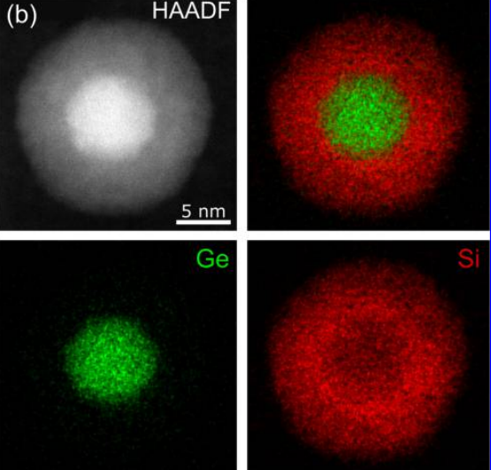
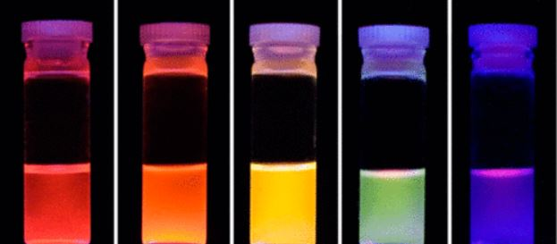
CORE/SHELL NANOPARTICLE (CSNP) SYNTHESIS IN NONTHERMAL PLASMA REACTORS
Core/Shell Nanoparticles(CSNPs) are a type of biphasic nanomaterial that has two components: an inner core and outer shell made of distinct materials.
The challenges in synthesizing reliable CSNPs lie in size uniformity, core and shell purity control.
Tuning core-to-shell thickness ratio alters CSNP optical properties for optoelectronics applications.
Focus here is CSNPs with Ge core and Si shell.
This work computationally investigates CSNP properties by varying operation parameters (inlet gas fraction, flow rate, ICP power).
• K. I. Hunter et al. ACS Appl. Mater. Interfaces 9, 8263 (2017).
• X. D. Pi et al. Nanotechnology 19, 245603 (2008).
University of Michigan
Institute for Plasma Science & Engr.
MIPSE_2023
Notes:
3

Slide 4
HYBRID PLASMA EQUIPMENT MODEL(HPEM) + DUST TRANSPORT SIMULATOR (DTS)
HPEM consists of modules to address physical processes in low-temperature plasmas using fluid and kinetic approach.
Dust Transport Simulator (DTS) module uses plasma properties generated by HPEM to compute NP growth, charging and trajectory tracking to visualize the behavior of NPs in nonthermal plasmas.
University of Michigan
Institute for Plasma Science & Engr.
MIPSE_2023
Notes:
4

Slide 5
DUST TRANSPORT SIMULATOR (DTS)
DTS work flow:
  Spatial temperature, densities, neutral and ion momenta, and electric fields from HPEM
  Initialize NPs; Compute growth, charging and various forces on the NPs
  Generates a 3-dimensional trajectory for each NP
  Feedback dust density and charge to HPEM
Forces on NPs:
  Electrostatic
  Gravitational
  Thermophoretic
  Ion drag
  Fluid drag
  Interparticle Coulombic and shielding
University of Michigan
Institute for Plasma Science & Engr.
MIPSE_2023
Notes:
5

Slide 6
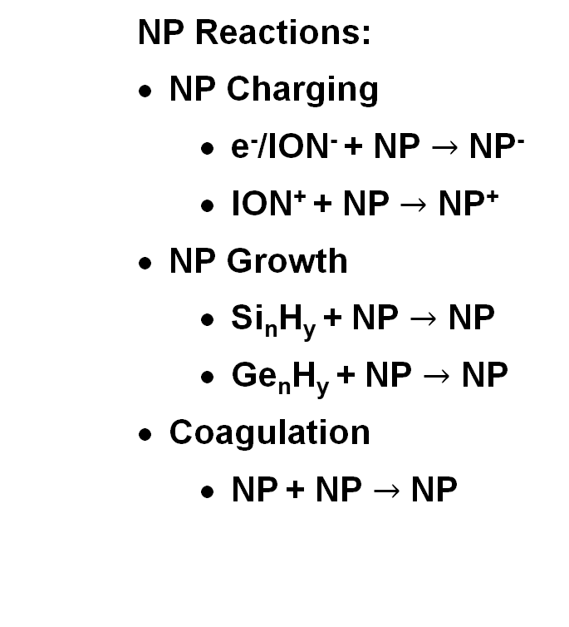
PLASMA CHEMICAL MECHANISMS
Species considered:
  Ar, Ar(1s₅), Ar(1s₄), Ar(1s₃), Ar(1s₂), Ar(4p), Ar(4d), Ar⁺, ArH⁺, e⁻
  Si, SiH, SiH₂, SiH₃, SiH_{4,} Si_{n}H_{2n+1} (n ≤12), Si_{n}H_{2n+2}(n ≤12), SiH⁺, SiH₂⁺, SiH₃⁺, Si₂H₂⁺, Si₂H₃⁺, Si₂H₅⁺, Si₂H₆⁺ SiH₂⁻, SiH₃⁻, Si₂H₃⁻, Si₂H₅⁻
  Ge, GeH, GeH₂, GeH₃, GeH_{4,} Ge_{n}H_{2n+1} (n ≤12), Ge_{n}H_{2n+2}(n ≤12), GeH⁺, GeH₂⁺, GeH₃⁺, Ge₂H₂⁺, Ge₂H₃⁺, Ge₂H₅⁺, Ge₂H₆⁺ GeH₂⁻, GeH₃⁻, Ge₂H₃⁻, Ge₂H₅⁻
  H₂, H₂*, H, H*, H⁺
  NP – nanoparticle, Si_{n>12} and Ge_{n>12}
  NP Reactions:
    NP Charging
      e⁻/ION⁻ + NP $→$ NP⁻
      ION⁺ + NP $→$ NP⁺
    NP Growth
      Si_{n}H_{y} + NP $→$ NP
      Ge_{n}H_{y} + NP $→$ NP
    Coagulation
      NP + NP $→$ NP
University of Michigan
Institute for Plasma Science & Engr.
MIPSE_2023
Notes:
6

Slide 7
PLASMA REACTOR CONDITIONS
Cylindrical two-coil ICP to create separated core and shell synthesis zones.
Design inspired by the work of K. I. Hunter et al. in Prof. Kortshagen’s group.
Reactor: 1 cm in radius, 15 cm in height.
Inlet gas flow:
GeH₄/Ar = 2/98, 50 sccm
SiH₄/Ar = 0.5-5/99.5-95, 5-50 sccm
Pressure: 1 Torr
Power:
10 W, 10 MHz (top coils)
5-20 W, 10 MHz (bottom coils)
University of Michigan
Institute for Plasma Science & Engr.
MIPSE_2023
Notes:
7

Slide 8
BASE CASE PLASMA PROPERTIES
n_{e}
5×10¹⁰ –
3.1×10¹² cm⁻³
T_{e}
0.5 – 5 eV
Potential
-31 – 7V
Plasma properties solved prior to NP initialization in DTS.
Potential and electron density peaks at slightly different values for top and bottom coil due to varying gas composition and flow rate.
Electron impact dissociative attachment causes n_{e} to decrease by two order of magnitude away from the coil region.
T_{e} decrease to ~1 eV downstream as a result of high collision frequency at 1 Torr.
1 Torr, 10/10 W, 50 sccm 2% GeH₄, 25 sccm 2% SiH₄
University of Michigan
Institute for Plasma Science & Engr.
Radius (cm)
MIPSE_2023
Notes:
8

Slide 9
BASE CASE GeH_{x} AND SiH_{x} SPECIES
GeH₄
2×10¹²-
5.1×10¹⁴
GeH₃
1×10¹⁰-
1.8×10¹²
GeH₂
1×10⁹-
2.2×10¹¹
GeH
2×10⁸-
3.7×10¹⁰
SiH₄
1×10¹²-
1.3×10¹⁴
SiH₃
5×10⁹-
6.7×10¹²
SiH₂
1×10¹⁰-
2.6×10¹²
SiH
2×10¹⁰-
3.2×10¹²
[cm⁻³]
Height (cm)
Radius (cm)
    GeH₄ and SiH₄ break down to Si/Ge hydride radicals through electron impact dissociation near the coil regions.
University of Michigan
Institute for Plasma Science & Engr.
MIPSE_2023
Notes:
9
Insertion reactions of radicals into Ge_{x}H_{y}, Si_{x}H_{y} then grow larger clusters.

Slide 10
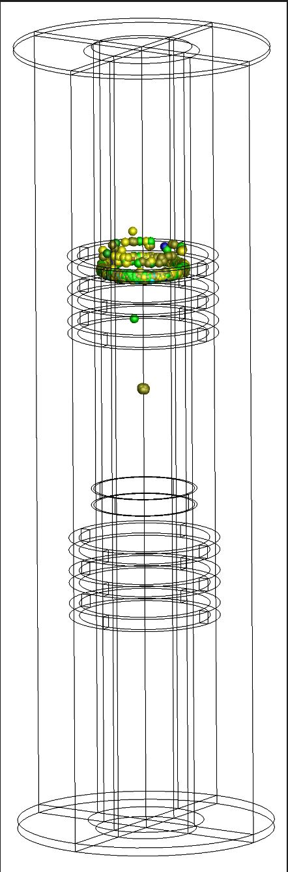
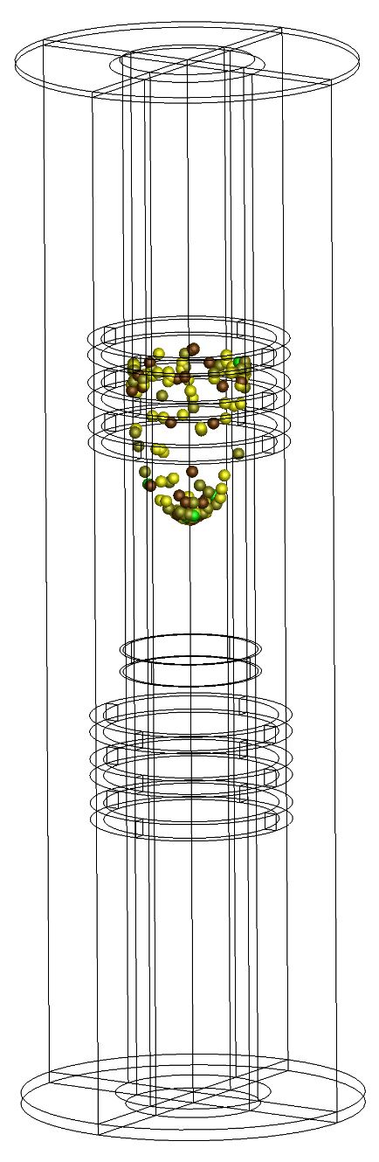
NP Radius
NP DYNAMICS
0.5 nm
6.5 nm
NPs are initialized as Ge cores with radius of 0.5 nm at 11-12 cm height.
Strong ion drag and electrostatic forces produce NP ring structure at the top coil region.
As NP grows, fluid drag accelerates NP down to be trapped in the location of maximum electric field of top coil.
The NPs grows to a critical size at which fluid drag dominates, flow down to the bottom coil.
The trapped NPs in the electrostatic trap (ring) eventually grow to a critical size for fluid drag to dominate and are collected.
University of Michigan
Institute for Plasma Science & Engr.
MIPSE_2023
Notes:
10

Slide 11
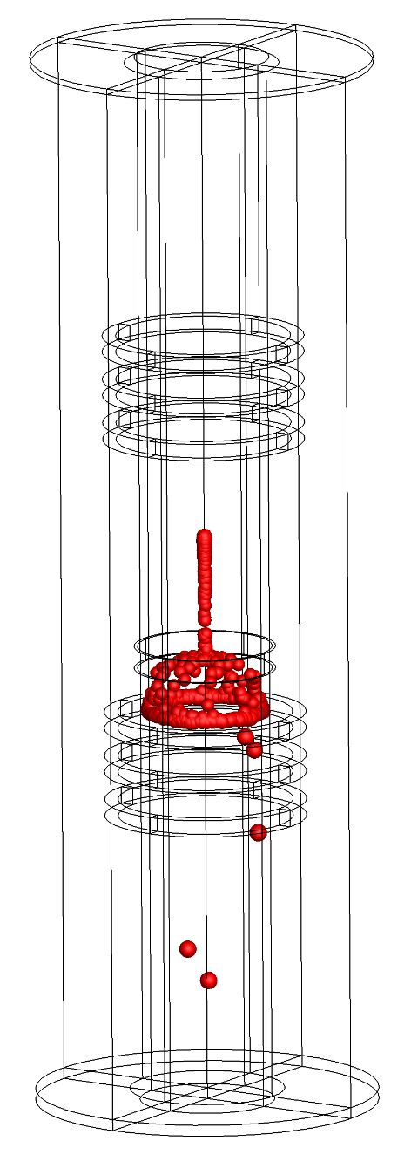
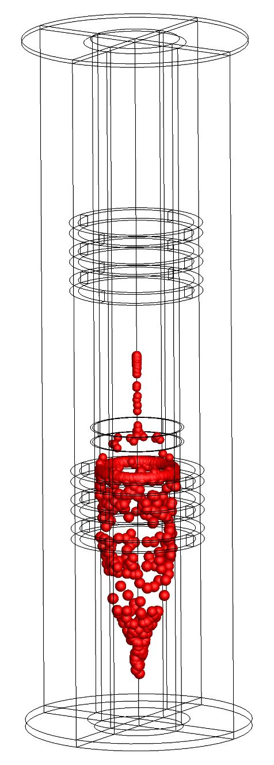
NP Radius
NP DYNAMICS
0.5 nm
6.5 nm
NPs are initialized as Ge cores with radius of 0.5 nm at 11-12 cm height.
Strong ion drag and electrostatic forces produce NP ring structure at the top coil region.
As NP grows, fluid drag accelerates NP down to be trapped in the location of maximum electric field of top coil.
The NPs grows to a critical size at which fluid drag dominates, flow down to the bottom coil.
The trapped NPs in the electrostatic trap (ring) eventually grow to a critical size for fluid drag to dominate and are collected.
University of Michigan
Institute for Plasma Science & Engr.
MIPSE_2023
Notes:
11

Slide 12
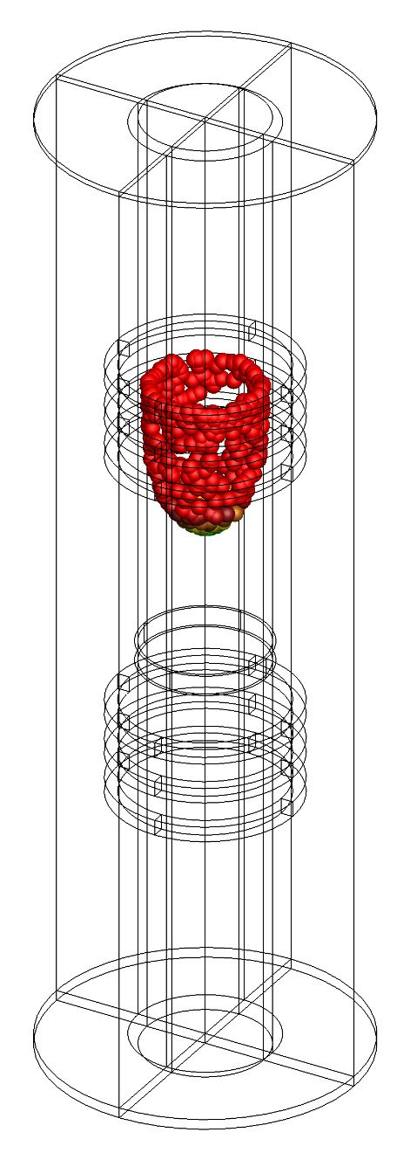
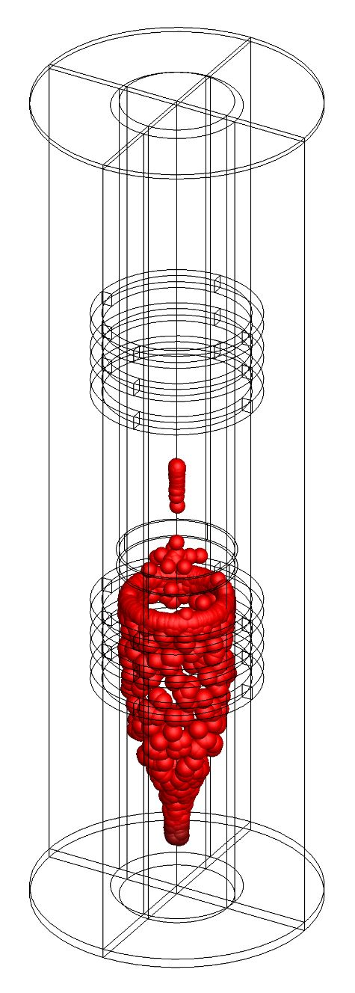
0%
100%
NP GROWTH
Ge Contribution
Si Contribution
Ge core is synthesized in the upper coil and then flows to the lower coil to produce Si shell.
Ge growth dominates the top region of while Si growth dominates the lower region.
The objective is to keep the core(Ge) and shell(Si) as pure as possible.
The transition zone between core and shell synthesis regions in the middle of the reactor is the greatest contributor to impurities.
Mass added to CSNP per unit time = Radical flux · NP surface area · Radical mass · Sticking coef.
University of Michigan
Institute for Plasma Science & Engr.
t = 1.81 – 1.91 s
t = 2.31 – 2.36 s
MIPSE_2023
Notes:
12

Slide 13
ADDITION TO Ge/Si COMPOSITION
Instantaneous growth contribution from both Ge and Si as a function of reactor height.
Ge or Si growth reflects average spatial density of growth species along the 3D trajectory of the NPs.
A core to shell growth transition point is height where Ge and Si growth crosses the 50% mark.
Ge
Si
The bumps near lower coil in Ge contribution are caused by the increase in Ge radical density due to dissociation of residual GeH₄.
University of Michigan
Institute for Plasma Science & Engr.
MIPSE_2023
Notes:
13
Ge dominates NP growth for top half of the reactor and Si dominates the bottom half.

Slide 14
LOWER INLET SiH₄ FLOW RATE
Lower inlet: Ar/SiH₄ = 98/2
Flow rate: 5 to 50 sccm.
SiH_{y} densities increase as the flow rate increases.
Core-to-shell growth transition point moves higher in the reactor as flow rate increases due to more back flow of silane gas mixture.
Core purity decreases as flow rate increase.
Higher density of Si radicals at higher flow rate improves shell purity.
Shell thickness decreases as flow rate increases.
Lower residence time with higher flow rate reduces the shell growth time.
Si
Ge
University of Michigan
Institute for Plasma Science & Engr.
MIPSE_2023
Notes:
14
50 sccm:
σ = 0.08 nm,
Ge/Si core/shell radius = 7.6/0.1 nm

Slide 15
LOWER INLET SiH₄ FRACTION
Lower inlet SiH₄ fraction: 0.5% to 5%.
As inlet SiH₄ fraction increases, SiH_{y} densities increase.
Transition point (core to shell) is higher in reactor with increasing SiH₄ fraction as the Si radicals expand more into upper region.
Core purity drops slightly with increase in SiH₄ fraction.
Shell purity increases with increasing SiH₄ fraction due to the higher densities of Si radicals compared to their Ge counterparts.
Similarly, NP shell thickness also increases due to higher availability of growth species.
Si
Ge
University of Michigan
Institute for Plasma Science & Engr.
MIPSE_2023
Notes:
15

Slide 16
LOWER COIL ICP POWER
Lower coil ICP: 5 to 20 W.
SiH_{y} densities increase as electron impact dissociation occurs more rapidly at elevated power density.
The reduced Si to Ge radical ratio as a result of the lower ICP power forms more distinguishable Ge peak at the lower coil.
Core purity decreases as ICP power increases.
Shell purity increases as the ICP power increases.
Shell thickness increases due to stronger electrostatic trapping force induced by the higher electric field as well as the larger density of growth species at the lower coil region.
Si
Ge
thickness
University of Michigan
Institute for Plasma Science & Engr.
MIPSE_2023
Notes:
16

Slide 17
CONCLUDING REMARKS
  Ge/Si Core/Shell nanoparticles growth and trajectories are simulated in a two-coil ICP reactor using HPEM + DTS.
  Ge and Si growth contribution, core-to-shell ratio, and core/shell purity were investigated.
  Increasing flow rate of Ar/SiH₄ at lower nozzle results in a decrease in core purity and shell thickness while increasing shell purity.
  Increasing lower inlet silane fraction results in small decrease in core purity but a sizeable increase in shell purity and thickness.
  Increase in lower ICP power (Ar/SiH₄) decreases core purity and increases both shell purity and thickness.
  Varying operating parameters allows for core/shell thickness and purity to be adjusted for specific applications.
University of Michigan
Institute for Plasma Science & Engr.
MIPSE_2023
Notes:
17

